Slide 1
Lecture # 2
CSC336 Web Technologies
Credit Hours: 3(2, 1)

Slide 2


“Categories of Web Applications and Web
Architectures”

Slide 3
Introduction
Overview of web applications and architectures
Web applications use different structures to work efficiently and meet various needs. These structures, or architectures, help decide how the application is built, how it performs, and how well it can grow or handle complex tasks.
Importance of understanding different categories and architectural patterns
Understanding different categories and architectural patterns is crucial for designing effective, scalable, and user-friendly web applications tailored to specific needs and constraints.

Slide 4











Categories of Web Applications
Document- Centric
Social Web
Semantic Web

Slide 5


1. Document-Centric Web Applications
Focus on creating, managing, and sharing documents
Examples: Google Docs, Microsoft Office
Online, Dropbox Paper

Slide 6


Features of Document-Centric Apps
Real-time collaboration
Version control
Document sharing
Editing tools

Slide 7
2. Social Web Applications
Platforms for user interaction and content sharing
Examples: Facebook, Twitter, Instagram, LinkedIn

Slide 8
Features of Social Web Apps
User profiles
News feeds
Social interactions (likes, comments, shares)
Notifications

Slide 9
3. Semantic Web Applications
Uses data with semantic meaning to enhance user experience Examples of semantic web applications include:
Wolfram Alpha: Provides answers to queries based on structured data and computational algorithms.
Google Knowledge Graph: Enhances search results with contextual information about entities.
Schema.org: Facilitates the use of structured data to improve search engine understanding of web content.

Slide 10
Features of Semantic Web Apps
ENHANCED SEARCH
CAPABILITIES
DATA INTEGRATION
CONTEXT-AWARE INFORMATION RETRIEVAL
IMPROVED DATA
RELATIONSHIPS

Slide 11
Aspect | Document-Centric Web | Social Web | Semantic Web
Definition | Web apps mainly focused on delivering documents and information to users | Web apps that enable social interaction, collaboration, and content sharing | Web apps that enable data to be understood and processed by machines, providing smart, linked data
Key Features | HTML pages, PDFs, articles Mostly static content Limited user interaction | User profiles, social networking Content creation & sharing Comments, likes, and collaboration | Use of metadata Linked data and ontologies Machine-readable content
Pros | Easy to develop and maintain Fast content delivery | Encourages collaboration and engagement - Dynamic content | Data is machine-readable- Enables intelligent apps and search Better interoperability
Cons | Limited interactivity- Not personalized | Privacy & security concerns Can be complex to maintain | Requires structured data Complex development Less intuitive for regular users
Use Cases | News websites - Online documentation - E-books | Social networks Forums Collaborative platforms | Knowledge graphs Intelligent agents Data integration systems
Examples | Wikipedia (document browsing) Online documentation sites | - Facebook, Twitter, LinkedIn | - DBpedia, Google Knowledge Graph, semantic search tools

Slide 12
Interoperability means:
The ability of different systems, applications, or components to work together, exchange data, and use that data effectively, even if they are built on different platforms or technologies.

Slide 13
Web Architectures

Slide 14
Web Architectures Overview
Introduction to architectural patterns:
Layered Architecture
One-Tier
Two-Tier
Three-Tier
N-Layered Architecture

Slide 15
Layered Architecture
Structure: Presentation Layer, Business Logic Layer, Data Layer
Benefits: Separation of concerns, modularity, scalability
Separation of concerns involves dividing a system into distinct sections, each handling a specific aspect of functionality;
modularity allows for independent development and maintenance of these sections
Scalability ensures that the system can handle increased loads or complexity effectively.

Slide 16
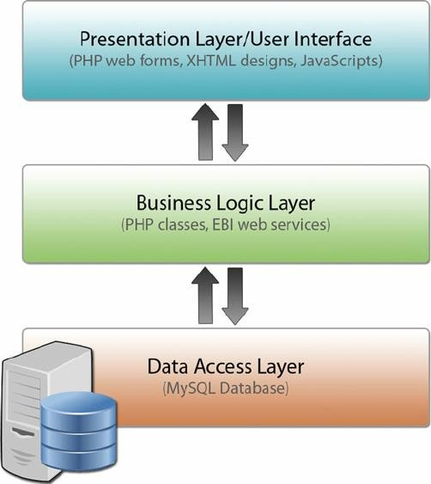
Diagram of Layered Architecture

Slide 17
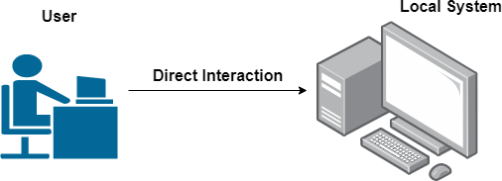
One-Tier Architecture
Also known as Single-Tier
All components integrated into a single system
Examples: Desktop applications or simple applications

Slide 18
Two-Tier(C-S) Architecture
Structure: Client-Server
Client handles presentation; server manages data
Examples: Basic client-server applications, such as online forms

Slide 19
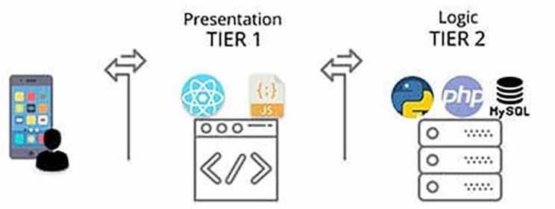
Diagram of Two-Tier Architecture
Visual representation of Client and Server layers

Slide 20
Three-Tier Architecture
Structure: Presentation Tier, Application Tier, Data Tier
Benefits: Improved scalability, separation of concerns, easier maintenance

Slide 21
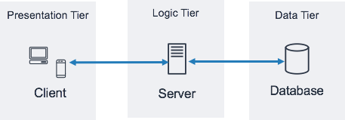
Diagram of Three-Tier Architecture
Visual representation of Presentation, Application, and Data Tiers

Slide 22
N-Layered Architecture
Extension of layered architecture with multiple layers:
Presentation
Application
Domain
Data Access
Benefits: Flexibility, modularity, scalability, maintainability

Slide 23
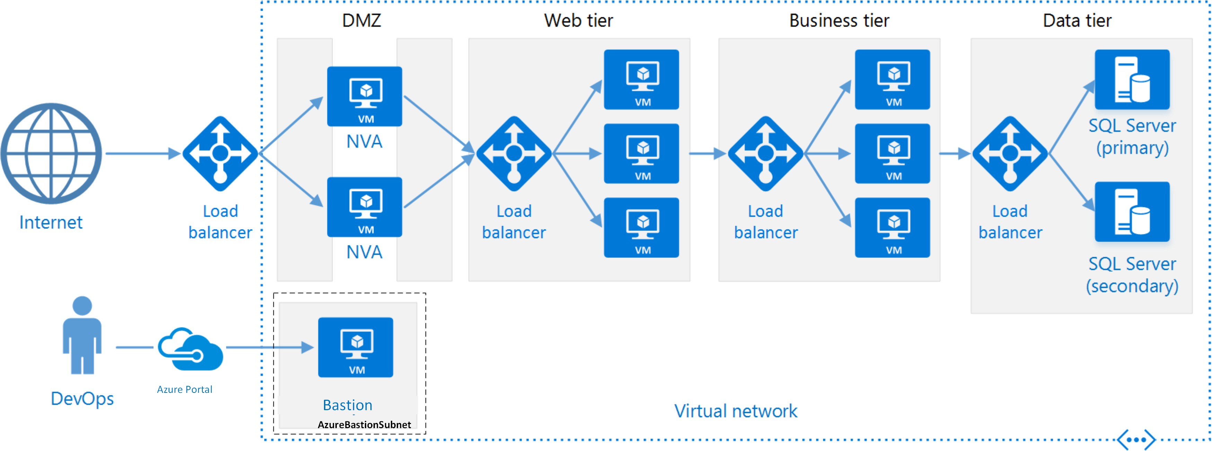
Diagram of N-Layered Architecture
Visual representation of multiple layers and their interactions

Slide 24
Aspect | Layered Architecture | One-Tier Architecture | Two-Tier Architecture | Three-Tier Architecture | N-Layered Architecture
Definition | System is divided into layers, each with specific responsibilities | All components reside in a single layer | Client communicates directly with a server that handles both logic and DB | Application split into Presentation, Logic, and Data layers | Multiple layers (more than 3) separate concerns for complex systems
Key Features | Clear separation of concerns, modular | Single deployable unit, tightly coupled | Client-server model, server handles logic & DB | Presentation layer (UI), Business Logic layer, Data layer | Modular layers for presentation, logic, service, integration, data, etc.

Slide 25
Aspect | Layered Architecture | One-Tier Architecture | Two-Tier Architecture | Three-Tier Architecture | N-Layered Architecture
Pros | Easier maintenance and testing, modularity | Simple, easy to develop | Easier than monolithic, better organization | Scalable, easier to maintain, separation of concerns | Highly modular, scalable, re-usable components
Cons | Overhead of layer communication, slower performance | Hard to scale, tightly coupled | Server can become bottleneck(apoint in a system that slows down the overall performance because it cannot handle the workload efficiently) | More complex, requires more infrastructure | More complex to design and manage, more development time

Slide 26
Aspect | Layered Architecture | One-Tier Architecture | Two-Tier Architecture | Three-Tier Architecture | N-Layered Architecture
Use Cases | Enterprise apps, maintainable systems | Small apps, desktop apps | Small client-server apps, internal tools | Web apps, enterprise solutions | Large-scale enterprise systems, complex apps
Examples | Banking systems, ERP | Microsoft Excel (desktop app) | Client-server database apps | Online shopping sites | Amazon, large distributed enterprise apps

